Slide 1
基于内容的图像检索综述
2017-12-18

Slide 2
Review
手工特征
基于CNN的特征
特征编码
特征检索

Slide 3
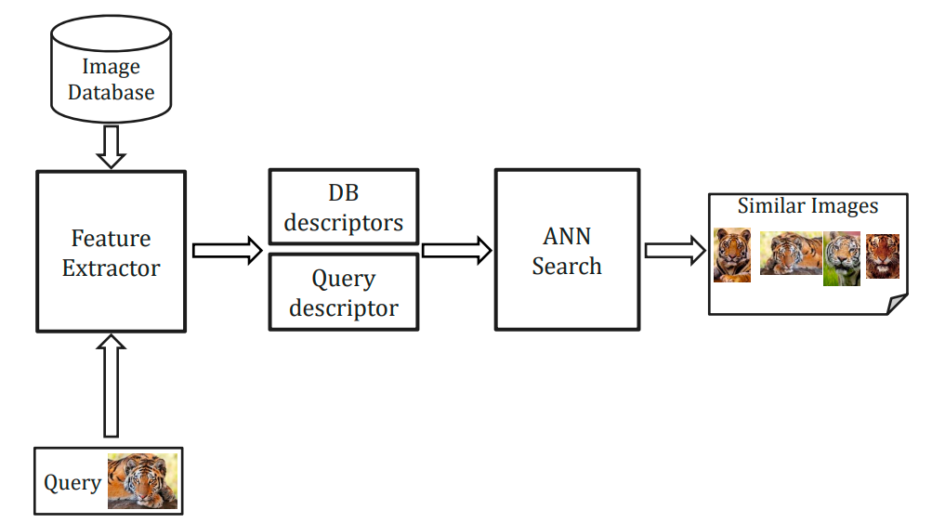
图像检索流程
Building index
Inverted index
Rerank/Query expansion

Slide 4
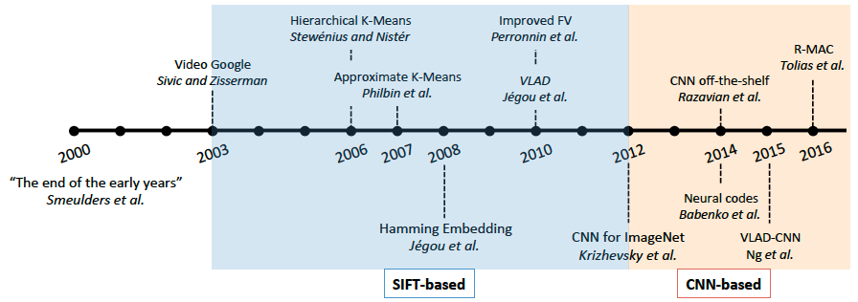
Instance检索趋势

Slide 5
手工特征
局部特征
Sift
Surf
Orb
Akaze
全局特征
Gist

Slide 6
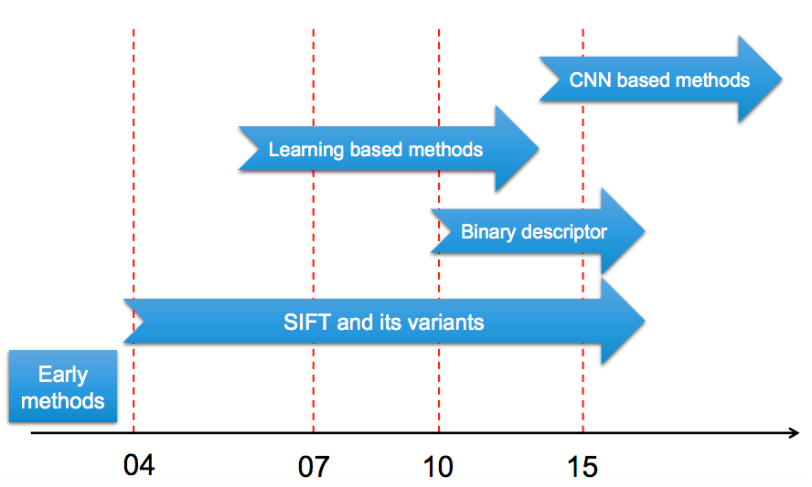
Local feature trends

Slide 7
手工局部特征的优势
对于几何还原的需求，仍然不可替代
能够满足实时应用
不需要因为新应用而重新训练特征

Slide 8
二进制特征 vs 实数特征
存储更高效，
Sift，floating，32x128 = 4096bit
Akaze，binary，486bit，10x
匹配速度更快，
Eucliead distance vs Hamming distance，10x~100x

Slide 9
特征编码
BOW
VLAD (Vector of Locally Aggregated Descriptors )
Fisher Vector

Slide 10
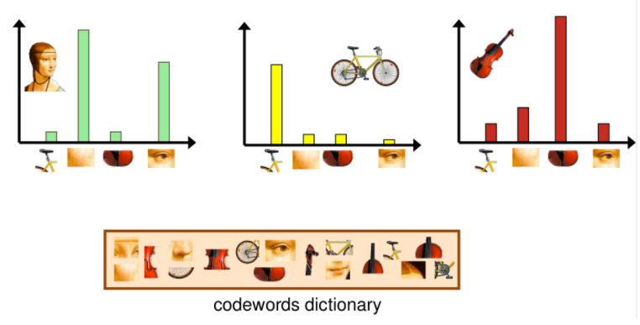
BOW

Slide 11
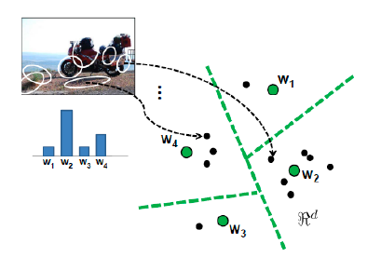
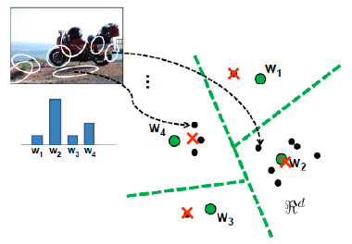
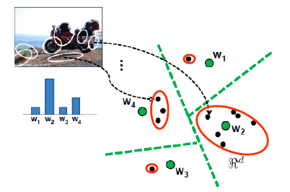
BOW
Count
Mean
Variance

Slide 12
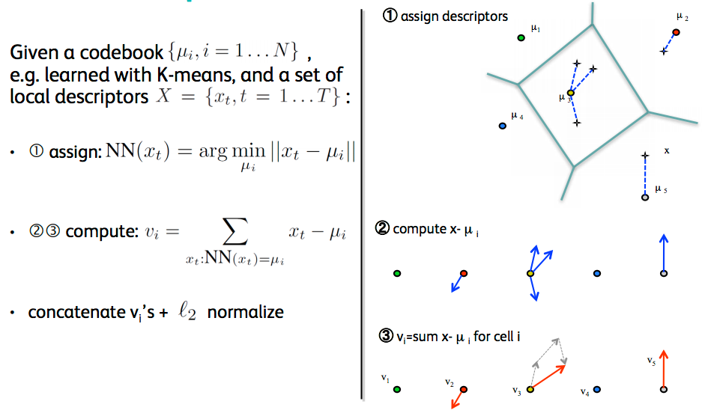
VLAD
Jégou, Aggregating local descriptors into a compact image representation，2011

Slide 13
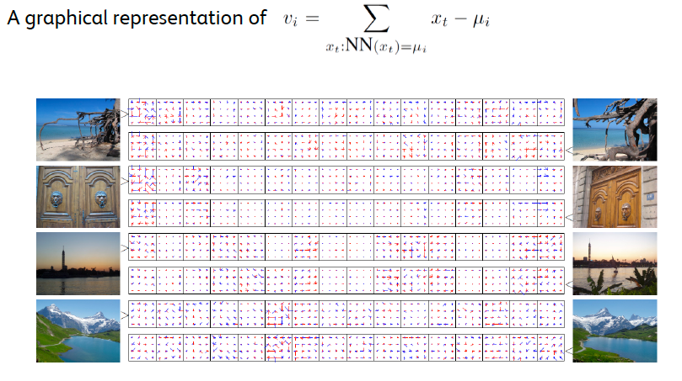
VLAD

Slide 14
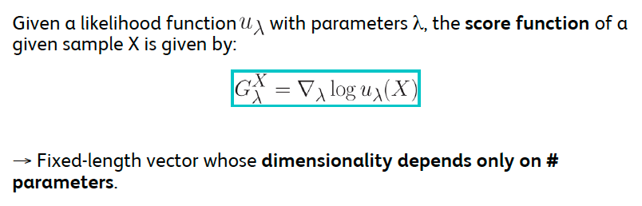
Fisher Vector
Jégou, Aggregating local descriptors into a compact image representation，2011，TPAMI

Slide 15
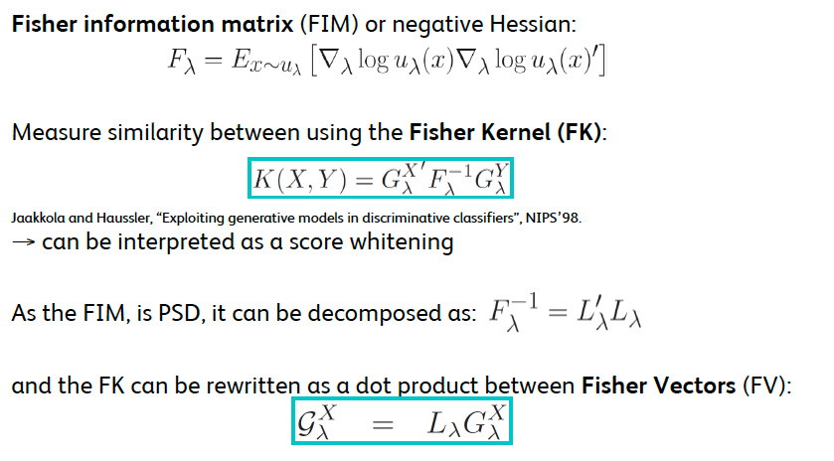
Fisher Vector
Jégou, Aggregating local descriptors into a compact image representation，TPAMI

Slide 16
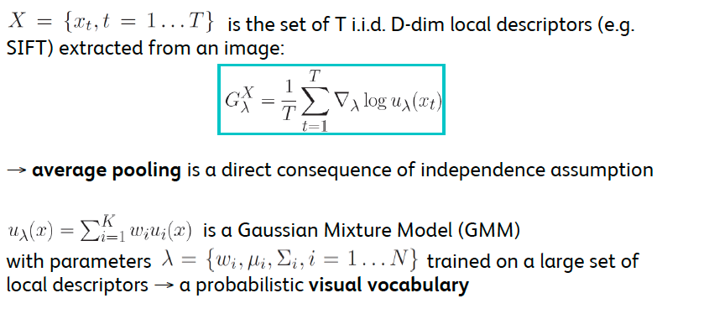
Fisher Vector
Jégou, Aggregating local descriptors into a compact image representation，2011 TPAMI

Slide 17
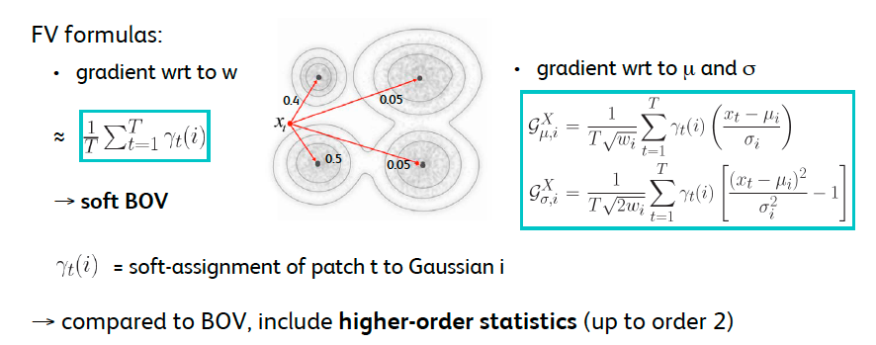
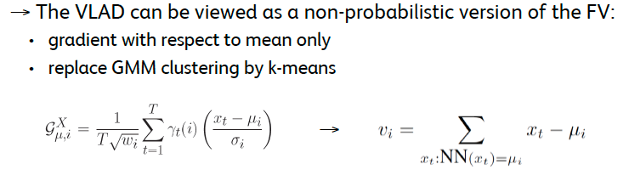
Fisher Vector
Jégou, Aggregating local descriptors into a compact image representation，2011 TPAMI

Slide 18
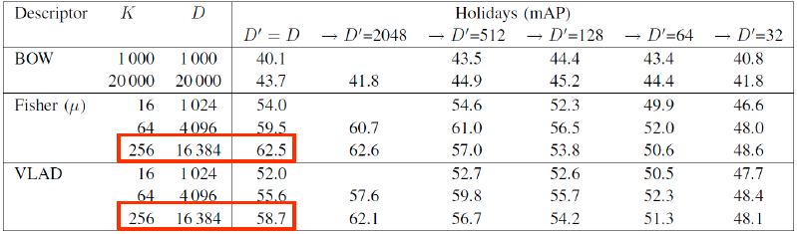
Fisher Vector
Jégou, Aggregating local descriptors into a compact image representation，2011 TPAMI

Slide 19
基于CNN的特征
Hybird Method
A. Sharif Razavian, H. Azizpour, J. Sullivan, and S. Carlsson, “Cnn features off-the-shelf: an astounding baseline for recognition
Y. Gong, L. Wang, R. Guo, and S. Lazebnik, “Multi-scale orderless pooling of deep convolutional activation features,”
Using pre-trained CNN
J. Ng, F. Yang, and L. Davis, “Exploiting local features from deep networks for image retrieval,”
G. Tolias, R. Sicre, and H. JŽgou, “Particular object retrieval with integral max-pooling of cnn activations,”
Using fine-tuned CNN
A. Babenko, A. Slesarev, A. Chigorin, and V. Lempitsky, “Neural codes for image retrieval,”
A. Gordo, J. Almaz‡n, J. Revaud, and D. Larlus, “Deep image retrieval: Learning global representations for image search,”
F. Radenovi«c, G. Tolias, and O. Chum, “Cnn image retrieval learns from bow: Unsupervised fine-tuning with hard examples,”
End-to-End CNN
Delf, LIFT

Slide 20
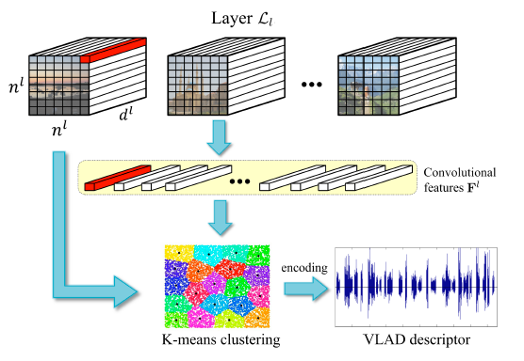
基于CNN的特征
局部特征, Image-level
Exploiting Local Features from Deep Networks for Image Retrieval
BOW

Slide 21
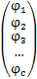
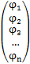
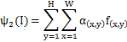
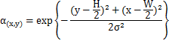
基于CNN的特征
局部特征, Image-level
Aggregating Deep Convolutional Features for Image Retrieval
Conv3-512
sum pooling
PCA
H=37
C=512
C=512
N=256
W=37
f(0,0)

Slide 22
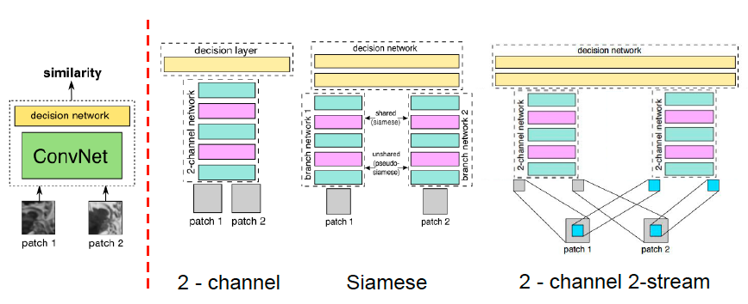
基于CNN的特征
局部特征, Patch-level
S. Zagoruyko and N. Komodakis. Learning to compare image patches via convolutional neural networks. CVPR, 2015.

Slide 23
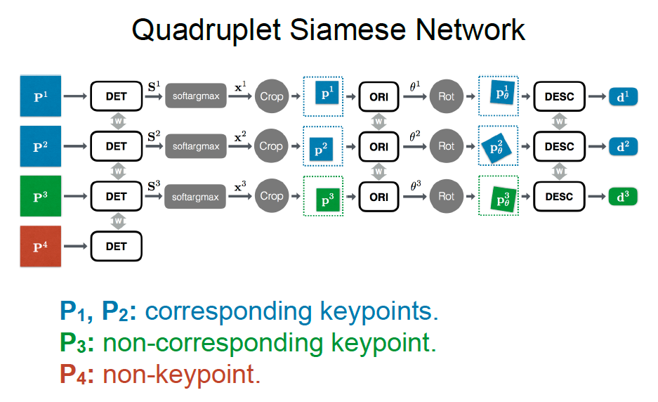
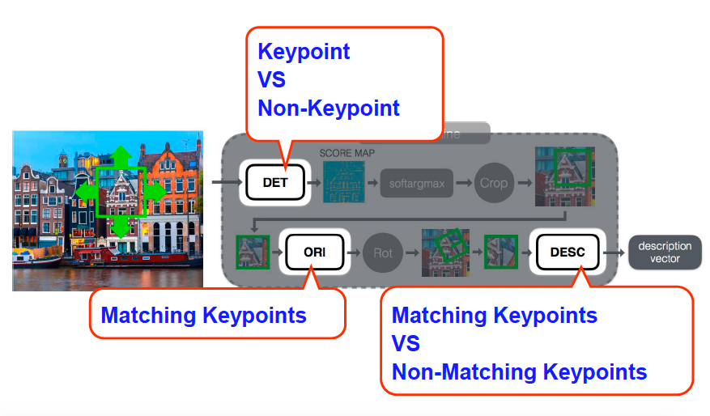
基于CNN的特征
局部特征, Patch-level
Kwang Moo Yi, Eduard Trulls, Vincent Lepetit, and Pascal Fua. LIFT: Learned invariant feature transform. In ECCV 2016.

Slide 24
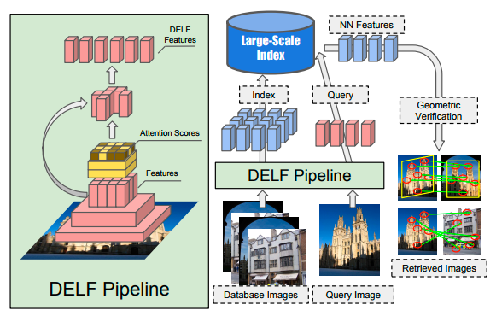
基于CNN的特征
局部特征
Large-Scale Image Retrieval with Attentive Deep Local Features (Delf feature)

Slide 25
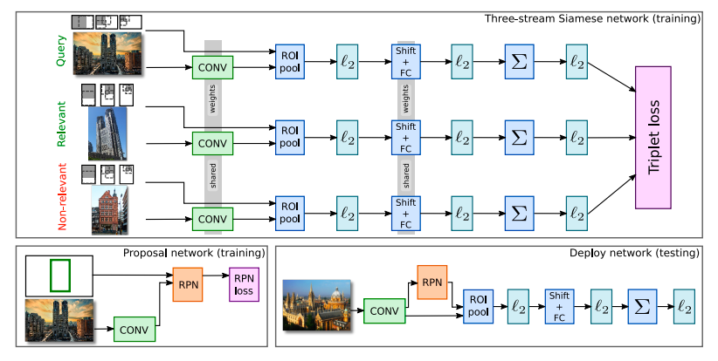
基于CNN的特征
全局特征
Deep image retrieval: Learning global representations for image search

Slide 26
基于CNN的特征
Patch level数据集(Brown dataset), 基于学习明显好于手工特征
Image level数据集(VGG dataset), 基于学习和手工特征差别不明显
CNN是基于学习的特征提取的主流.
基于学习的特征点检测被忽视

Slide 27
特征检索
基于树的检索
实数特征：KD-tree
K-means tree
二进制特征：Hierarchical Indexing tree
Product quantization（乘积量化）
Optimized product quantization
哈希
局部敏感哈希
Inverted Index（倒排索引）

Slide 28
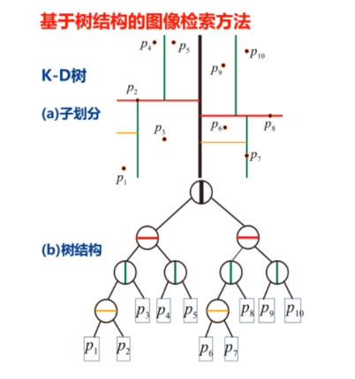
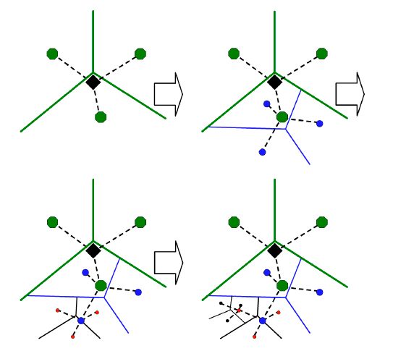
基于树结构的检索
KD-tree
Vocabulary tree (Hierarchical Kmeans tree)
Scalable Recognition with a Vocabulary Tree, 2006 CVPR
Hierarchical Indexing tree
Fast Matching of Binary Features, Muja and Lowe, 2012 CVPR

Slide 29
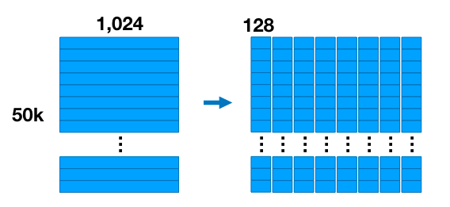
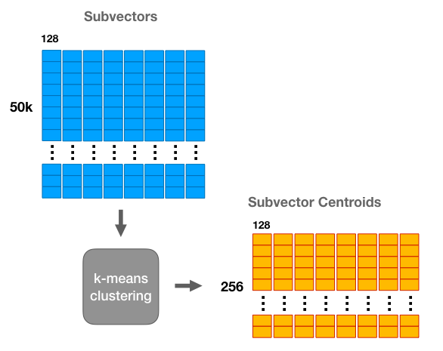
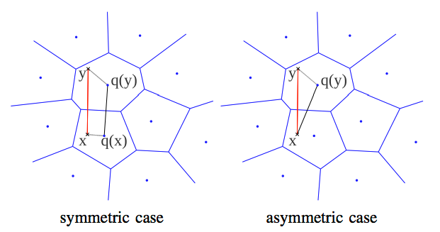
Product quantization（乘积量化）
Jégou, Product quantization for nearest neighbor search

Slide 30
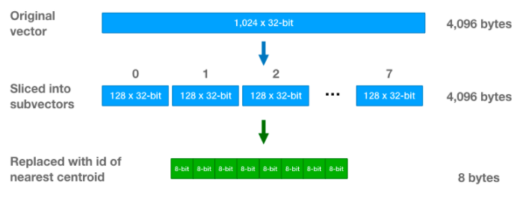
Product quantization
Jégou, Product quantization for nearest neighbor search

Slide 31
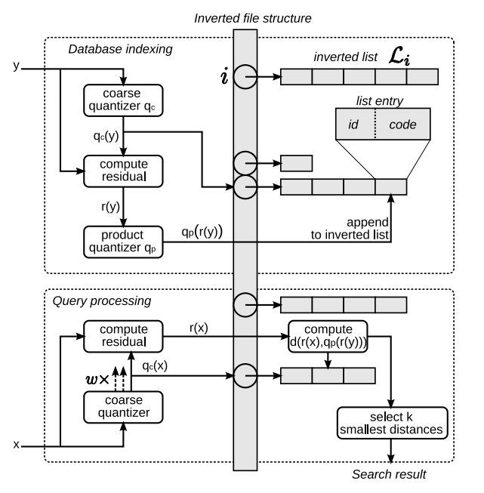
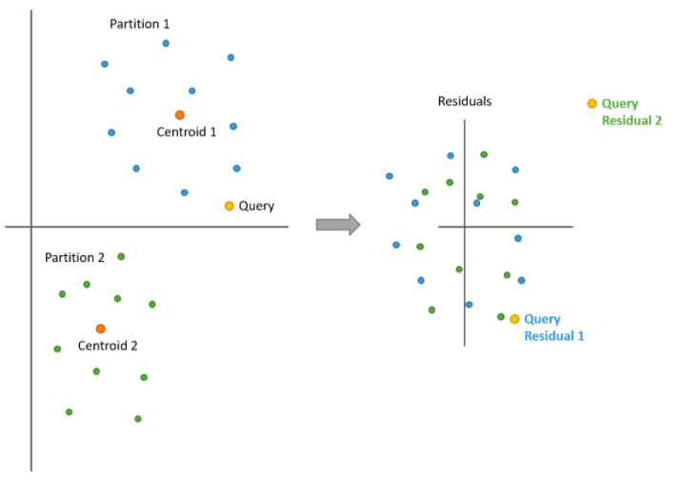
IVFADC

Slide 32
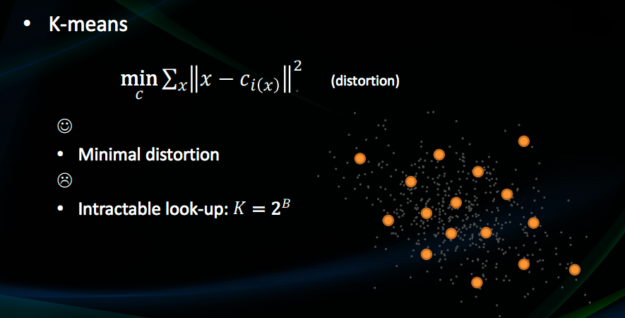
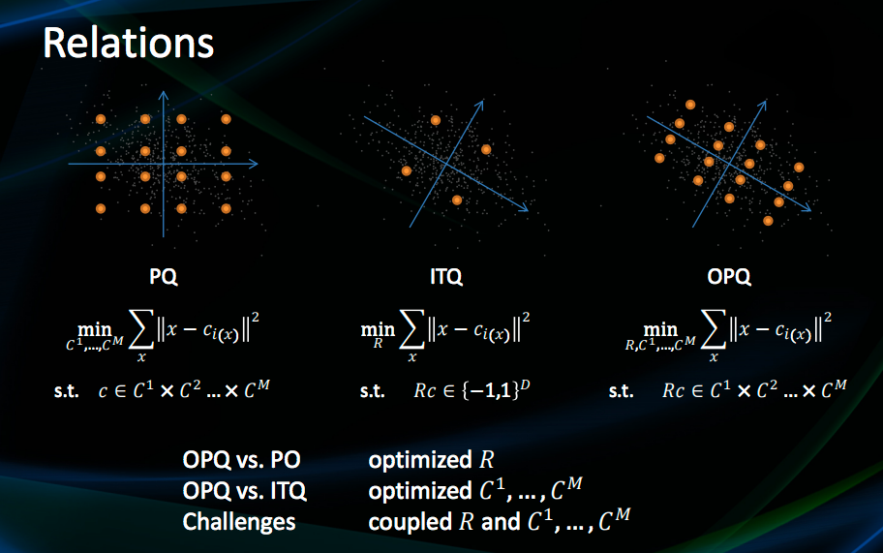
Optimized Product quanization
Optimized Product Quantization, by Tiezheng Ge, Kaiming He, Qifa Ke, and Jian Sun，2013 CVPR

Slide 33
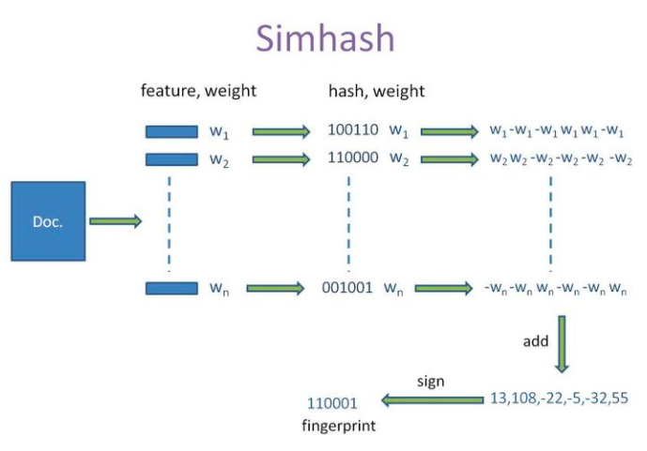
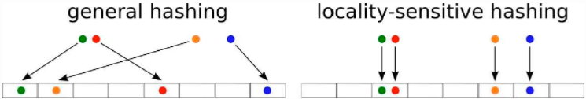
哈希
局部敏感哈希
Gurmeet Singh, Manku; Jain, Arvind; Das Sarma, Anish (2007), "Detecting near-duplicates for web crawling"

Slide 34
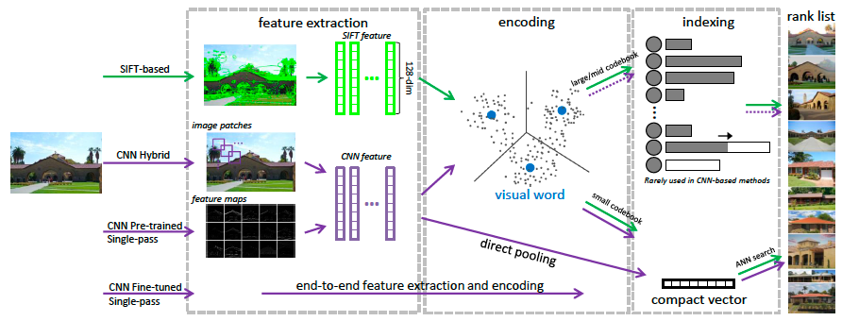
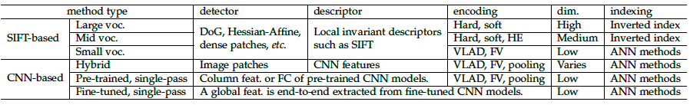
SIFT vs CNN

Slide 35
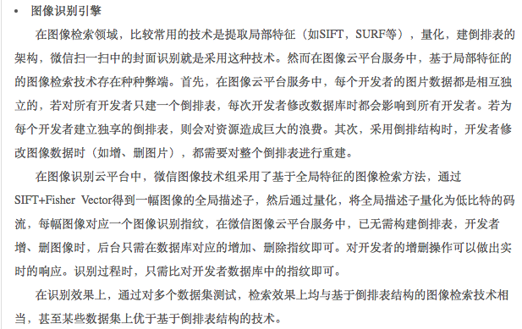
实际用例
微信拍图

Slide 36
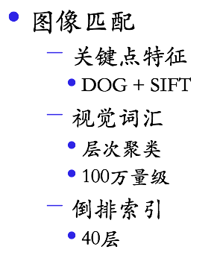
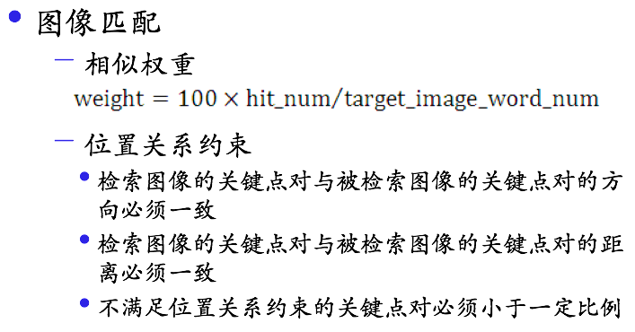
实际用例
百度识图，2012

Slide 37
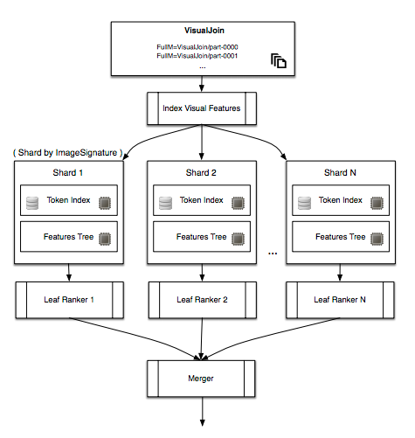
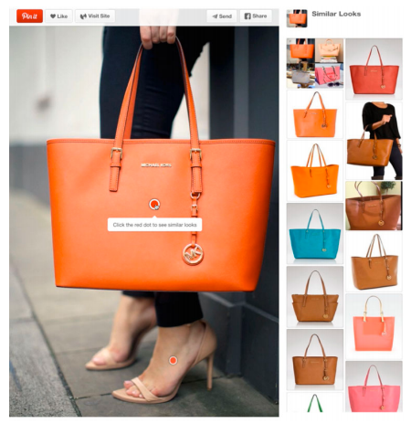
实际用例
Visual search at Pinterest
Yushi Jing1 , David Liu1 , Dmitry Kislyuk1 , Andrew Zhai1 , Jiajing Xu1 , Jeff Donahue

Slide 38
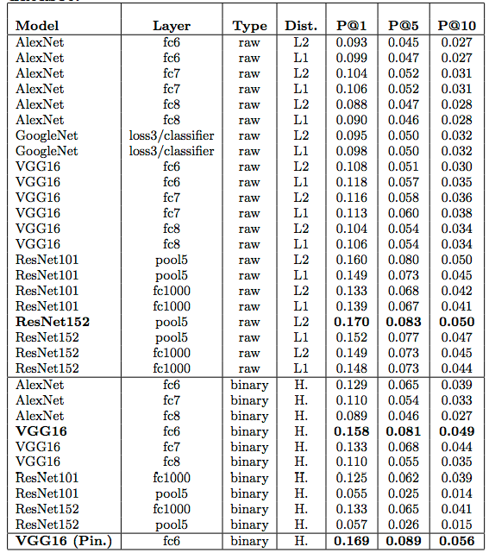

实际用例
Visual discovery at Pinterest
Andrew Zhai1∗ , Dmitry Kislyuk1∗ , Yushi Jing1∗ , Michael Feng1 Eric Tzeng12 , Jeff Donahue12 , Yue Li Du1 , Trevor Darrell

Slide 39
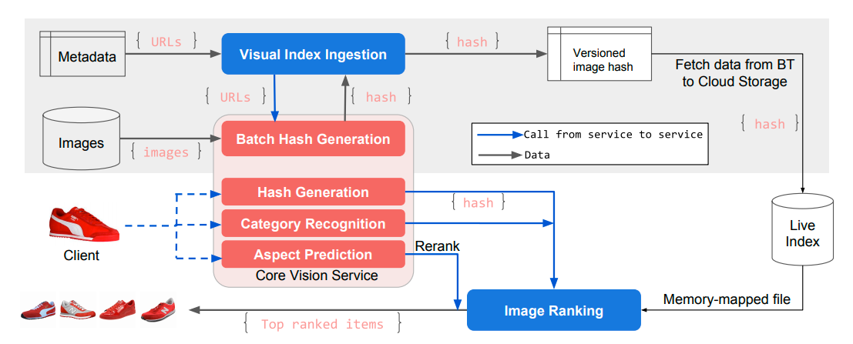
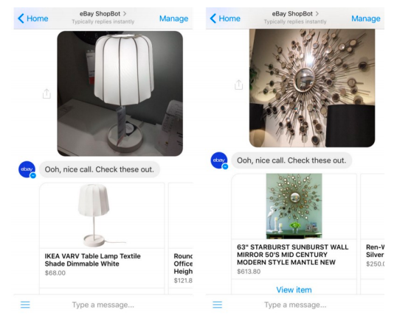
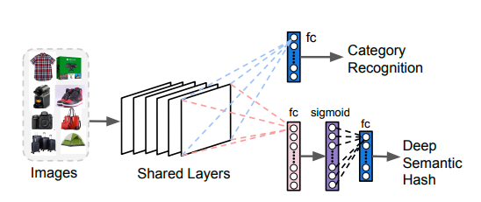
实际用例
Visual search at eBay
F Yang, A Kale, Y Bubnov, L Stein, Q Wang，Visual search at eBay

Slide 40
完

